Slide 1
The Motion Recognition Algorithm --- Step Count Algorithm
Student: Jerry / Jie Sun
Tutor: Dr. Glavin, Frank

Slide 2
Catalogue:
1.What is G-sensor and what is Step Algorithm?
2.How does G-sensor work?
3.The Principle of Step Algorithm.
4.The demostration of my programme.
Notes:
This page is just only for Summarizing this powerpoint to let the audinance have a overall concept.

Slide 3
What is G-sensor? What is Step Count Algorithm?
A G-sensor is commonly referred to as an accelerometer. They are used in a wide range of devices like smart phones, vehicles.
Step Count Algorithm is a kind of algorithm which makes use of the G-sensor or other sensors put on human body to calculate how many steps the people walk or run.

Slide 4
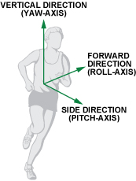
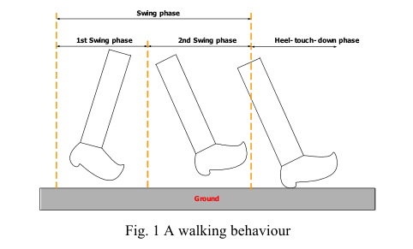
How does G-sensor work?
When a pedestrian is walking on the road, the accelerometer will divide the motion acceleration by three directions, as we can see in the picture below: Vertical Direction, Forward Direction and Side Direction, which can be also called: X, Y and Z Axis.
Those Pictures from ----Full-Featured Pedometer Design Realized with 3-Axis Digital Accelerometer / By Neil Zhao

Slide 5

Analysis of Three Axes Accelerations
As we can see in the two pictures on the left, where a , h , g means horizontal acceleration, vertical acceleration and gravity force, respectively.
Which from Paper: A Step, Stride and Heading Determination for the Pedestrian
Navigation System
Notes:
The strides of the walker are different according to the varying human parameters. The stride depends on several factors such as walking velocity, step frequency and the height of the walker etc.
The horizontal direction acceleration and vertical direction acceleration during the swing phase is denoted in equation below, where θ(t) is inclination angle of the leg at time t.

Slide 6
The Principle of Step Algorithm.
Rule 1: Calculating the total acceleration value from three seperate directions' accelerations. (Trend)
Rule 2: Finding the positive peak value and nagative peak value and filtering the invalid values.
Rule 3: Defining the Threshold Values for filtering the interference values.
Notes:
This chart on the right shows the total acceleration wave of walking in pocket during 2 seconds from the 2.5 minutes above chart. From the diagram, we can mark some positive and negative peak values, and there are some rules for judging whether peak values are available or not:

Slide 7
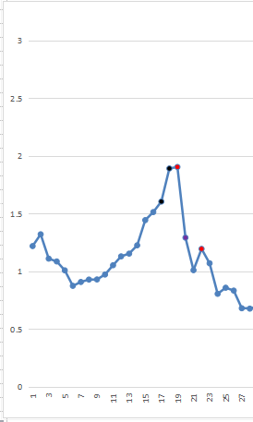
Positive Peak
Thershold Values

Slide 8
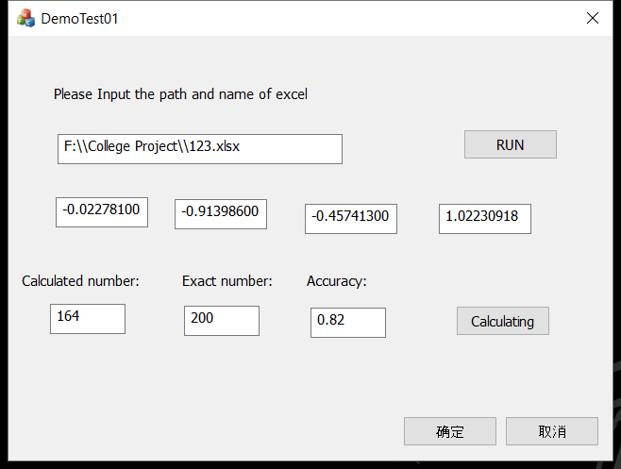
My Own Porgram
This is My Programme

